Slide 1

Enhancing Collaboration Between GpGx and CSC
Meir Glick and Michael Altman
On behalf of Computational & Structural Chemistry

Slide 2


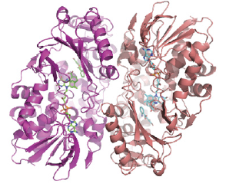
Scope and Aims of the Brainstorming Meeting
Compound and Structural Knowledge
Genetic Studies
CRISPR-Cas9
Clinical Samples
GWAS
MOAset
ChemGenie
Competitive Intelligence WB
Virtual Screening
mPDB
Homology Modeling
Impact the pipeline by rapidly selecting the most chemically tractable targets
Reduce attrition early- “validate” or “de-validate” targets from genetic studies

Slide 3
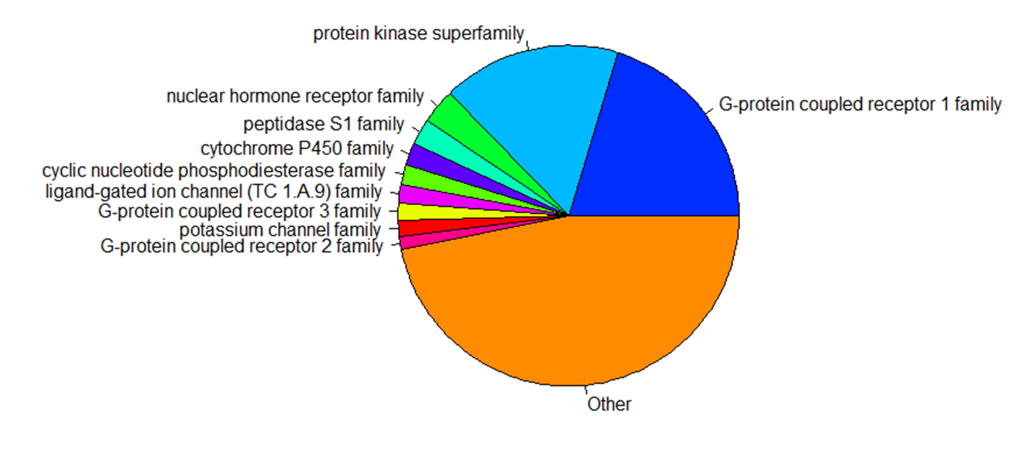
Mechanism of Action (MOA) Set
A highly annotated set that can reveal mode of action in phenotypic and cell based screens.
Covering a broad range of biological targets
The compounds were selected based on their tool score which factors in selectivity, number of assays, and assay source.
Notes:
Add info around # compounds in the database, targets, etc

Slide 4
CHEMGENIE DB: Chemical Genetic Interaction Enterprise
CHEMGENIE
bioinformatics
chemoinformatics
Data curation and
harmonization
Lit Tool
Compounds
ChemicalProbes.org
Metabase
Project team dose response
HTS
dose response
NCBI gene
NIH Probes
Guide to
Pharmacology
Kinase panel
Internal PDB
UniProtKB
ChEMBL
PDB
PanLabs
Global
counterscreen
MK annotation
Legacy
Schering Plough
ALIS
Notes:
Add info around # compounds in the database, targets, etc

Slide 5
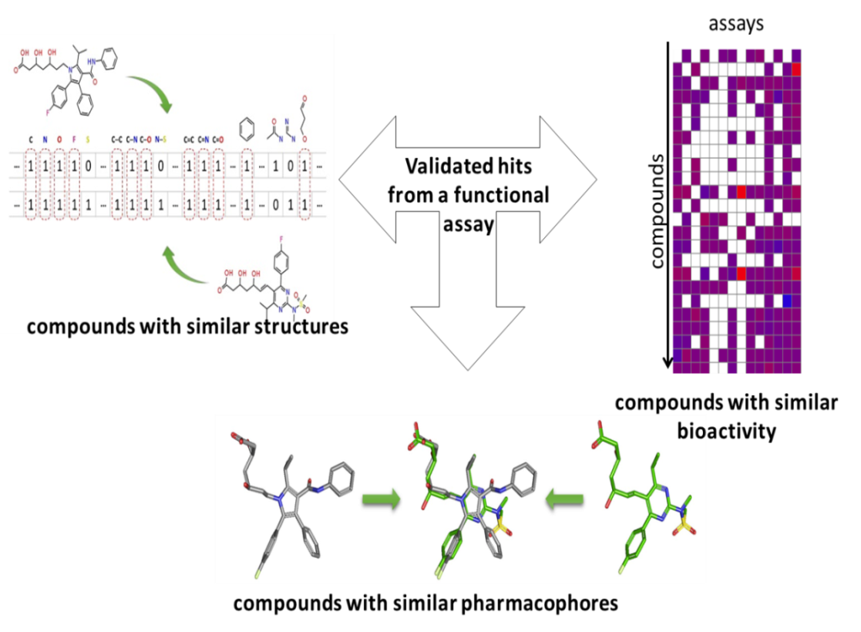
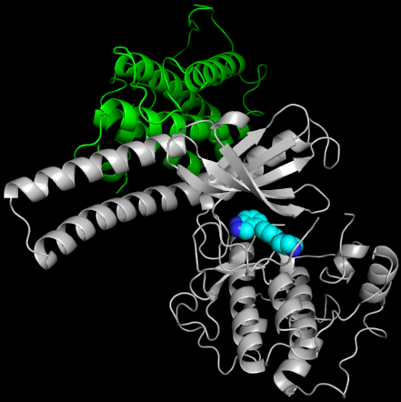
Virtual Screening
Merck (3.7M)
Commercial (>10M)
Readily Synthesizable (>100M)
Experimental
Testing
Docking
IFS
Ligand Based – Given (putative) active compounds, find more that “look similar”
Receptor Based – Given a structure (or model), find compounds that might bind
Bioactivity Based – Given compound activities, find more that have the same profile
Iterative Focused Screening – Multiple “VS & Test” cycles until sufficient chemical matter
Notes:
Add info around # compounds in the database, targets, etc

Slide 6
How Many Compound-Knowledge-Enabled Targets are Out There?
GAP
“Knowledge Space”
~10,000 targets with known ligandable domains or sufficient homology for modeling
“Targeted Space”
~1000 targets in ChemGenie or of known structure
CSC Enabled Space
IL4I1: Starting from a successful virtual screen, expanded chemical matter with IFS to rapidly yield two fit-for-purpose chemical series for in vivo preclinical testing
LATS: ChemGenie combined with virtual screening identified a potent and selective hit which was rapidly optimized to an in vivo tool using structure and predictive models

Slide 7

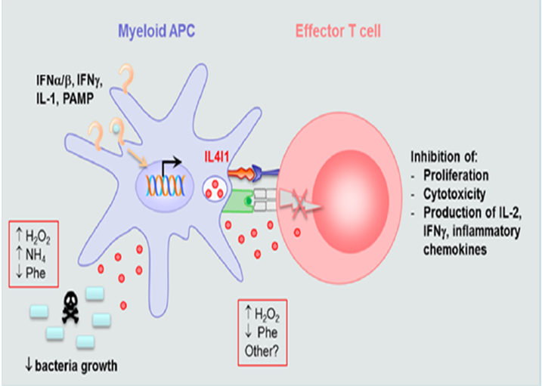
Iterative Focused Screening for Small Molecule Inhibitors of IL4i1
GpGx driven: Highly correlated with responder GEP, data support the immunosuppressive role of IL4I1 in promoting tumor escape
Virtual screening using protein family members
Ligand based screening
Purposeful Medicinal Chemistry
L-006366267
IL4I1 60nM
Rat MRT 2.3h
VLE 6.5
L-006364991
IL4I1 9nM
Rat MRT 1.9h
VLE 4.9
IL4I1 is a novel immunomodulatory amino acid metabolizing target similar to IDO1 and arginase
Virtual screening greatly accelerated small molecule LID and LO by identifying more than 20 chemotypes before the engagement of chemistry or HTS
Further chemistry optimization enabled in vivo experiments with a fit-for-purpose tool compound as soon as the animal models were ready

Slide 8
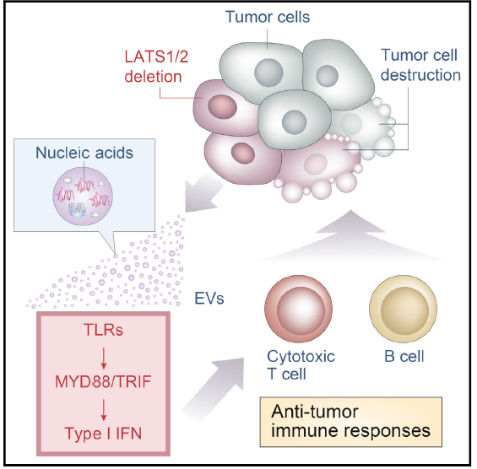


LATS Kinases – From Publication to Tools
Virtual Screen Leveraging Chemogenomic Databases and Machine Learning
Publication Implicating the LATS Kinases in Tumor Immunity
Purposeful Medicinal Chemistry and Homology-Model-Based Design
A Compelling Hit…
L-006306918
L-001897146
LATS2 IC₅₀ = 3 nM
% Kinases > 100X = 100%
Clean Off-Targets
Good Permeability & Solubility
Mouse PK:
CL_{u} = 170, VD_{u} = 38
T_{half,eff} = 2.5 h
%F = 90% @ 30 mpk
LATS2 IC₅₀ = 32 nM
LE / LLE = 0.48 / 4.4
% Kinases > 10/100X = 98%/82%
Clean Off-Targets
Stable in Microsomes
Promising Mouse PK
Moroishi et al. Cell. 2016 167(6):1525
Internal Crystal Structure of Inhibitor-Bound LATS2+MOB1A
L’6918 is a potent and selective LATS1/2 inhibitor with sufficient PK and properties for in vivo studies
Acutely tolerated up to 150 mpk
Cellular target engagement (via pYAP inhibition) confirmed across multiple syngeneic tumor lines
Cell studies also highlight unexpected pathway biology (reinforcing the utility of selective tools)
MTD and tumor efficacy studies planned

Slide 9
Discussion
How can we collaborate to prioritize the most chemically tractable targets? (GpGx→CSC)
How can we collaborate to link bioactivity data and target genetics? (CSC→GpGx)
How can we become more opportunistic in progressing novel target/compound pairs?
How can we efficiency navigate between compounds, domains, proteins, and genes?

Slide 10
Backups

